Slide 1


DATA 225 Database Systems for Analytics August 21 Class Meeting
Department of Applied Data Science San Jose State University Fall 2023 Instructor: Ron Mak
www.cs.sjsu.edu/~mak

Slide 2
Basic Info
Office hours
W 6:00 – 7:00 PM in Clark Hall CL 325
Website
Faculty webpage: http://www.cs.sjsu.edu/~mak/
Class webpage: http://www.cs.sjsu.edu/~mak/DATA225/
Syllabus
Lecture notes
Assignments

Slide 3

Short Bio
Lecturer at San Jose State University since Spring 2008
Department of Computer Science
Department of Applied Data Science
Department of Computer Engineering
Formerly
Senior Scientist at the NASA Ames Research Center and JPL
Research Staff Member, IBM Research
Software Strategist, Lawrence Livermore National Lab
Software developer, project lead, engineering manager, etc. at various Silicon Valley companies
http://www.cs.sjsu.edu/~mak/
Mission Control, Jet Propulsion Laboratory (JPL) NASA Mars Exploration Rover Mission

Slide 4
Course Objectives
The primary goal of this class is to learn the fundamentals of databases and data management tools and procedures.
Develop a significant data analytics application by the end of the semester.
You will gain important data management and project development skills that are valued by employers.

Slide 5
Course Objectives, cont’d
You will understand practical aspects of data modeling, relational databases, SQL, and object-relational mapping.
You will learn how to develop standalone, notebook, and GUI-based Python applications with a back-end database.
You will understand how to design and deploy operational databases and analytical databases.

Slide 6
Course Objectives, cont’d
You will learn how to extract, transform, and load (the ETL process) large datasets into a database.
Perform data wrangling.
You will also learn about data warehousing, OLAP (online analytical processing), and NoSQL databases.
We will look at some commercial business intelligence (BI) tools.

Slide 7
Course Objectives, cont’d
Not course objectives:
Deep expertise in any one topic
It’s up to you do further research as necessary for your projects.
Database theory
Implementation of database management system (DBMS)
Database administration (DBA)

Slide 8
Course Syllabus
See the syllabus for:
course learning outcomes
recommended books
useful websites
software to install
team project
exams and grading
course schedule

Slide 9
Project Teams
Assignments will be done by small project teams.
Form your own teams of 4 members each.
Choose your team members wisely!
It’s important to gain experience working with others on a team project.
Be sure you’ll be able to meet and communicate with each other and work together well.
No moving from team to team.

Slide 10
Project Teams, cont’d
Each team member will receive the same score on each team assignment and team project.
Submit your team information into Canvas (under “Assignments/Miscellaneous”) by Friday, August 25 at 11:59 PM:
Your team name
A list of team members, student IDs, and email addresses
Only one student per team
needs to submit team information.

Slide 11
Team Semester Project
A significant Python application that accesses a database or data warehouse to perform data analytics
GUI-based
more details about the project during the semester
Possible data sources
actual experimental data
data downloaded from the internet
fake but realistic data created by data generation tools such as mockeroo

Slide 12
Team Semester Project, cont’d
Each project team will give an oral presentation and demo at the end of the semester.
The rest of the class will participate in grading the oral presentation.
Written report

Slide 13
Individual Responsibilities
You are personally responsible for participating and contributing to your team’s work, and for understanding each part of the work for every assignment whether or not you worked on that part.

Slide 14
Postmortem Assessment Report
At the end of the semester, each student will individually turn in a short (one page) report:
A brief description of what you learned in the course.
An assessment of your personal accomplishments for your project team.
An assessment of each of your project team members.
This report will be seen only by the instructor.
Assessments by your team members can move your class grade up or down.

Slide 15
Final Individual Class Grade
Your final class grade will be adjusted up or down depending on your
level and quality of participation,
as determined by project tracking tools
and your teammates’ postmortem reports.
30% checkpoint exams 1, 2, 3
30% assignments
40% project
During the semester, keep track of your progress in Canvas.
At the end of the semester, students with the median score will get the B+ grade.
Higher and lower grades will then be assigned based on how the scores cluster above and below the median.
Therefore, your final class grade will be based primarily on your performance relative to the other students in the class.

Slide 16
Participation is Important!
Can move your final grade up or down, especially in borderline cases.
Participation in class.
Participation in your team.
As reported by the postmortem assessment reports.

Slide 17
What is Data?
Recorded facts that are accessible.
Facts can appear in different formats.
text
numbers
figures
graphs
images
audio/video recordings

Slide 18
Structured vs. Unstructured Data
Structured data is highly organized and formatted in a way to make it easy to access and search.
Unstructured data is everything else!
Printed and written text
Social media data (e.g., tweets)
Audio, video, satellite imagery
etc.
There’s a lot more
unstructured data
than structured data
in the world.

Slide 19
What is Information?
We access the data for some particular purpose.
To learn something.
To make a decision.
We obtain useful information from a collection of data by performing some activity, such as
Search through the data.
Process the data.
Manipulate the data in some form or fashion.

Slide 20
What is a Database?
A structured collection of related data stored on the computer.
Multiple people and programs can access the data in a database simultaneously.
The database is a shared repository of data in a format that is usable by multiple programs.
Tools to manage and manipulate the data.

Slide 21
Database Management System (DBMS)
A software system to create and maintain databases.
Enable programs and users to store, insert, update, retrieve, and delete data in databases.
Provide an application programming interface (API) for applications to access databases.
We will use the Python database APIs.
Tools to manage the databases.

Slide 22
Types of DBMS
Relational
It’s the most popular type of database in use today.
We will primarily use the MySQL relational DBMS in this class.
NoSQL
We will briefly cover the MongoDB NoSQL DBMS.
Object-oriented
Network
Hierarchical

Slide 23
Two Primary Use Cases of Databases
Operational database
Analytical database

Slide 24
Operational Database
Keep track of transactions and other data when they arrive.
Example: Record sales as they occur
Example: Record scientific data from ongoing experiments
Ad hoc lookups and updates
Usually store only the most recent data
OLTP: Online Transactional Processing
Most common use case
Especially for commerce.

Slide 25
Analytical Database
Analyze stored data
Example: Compare this quarter’s sales vs. last quarter’s sales.
Example: Analyze the trend of results from a series of experiments performed over time.
OLAP: Online Analytical Processing
Data mining
Large volumes of data
Can store archived and historical data
Data warehouse

Slide 26
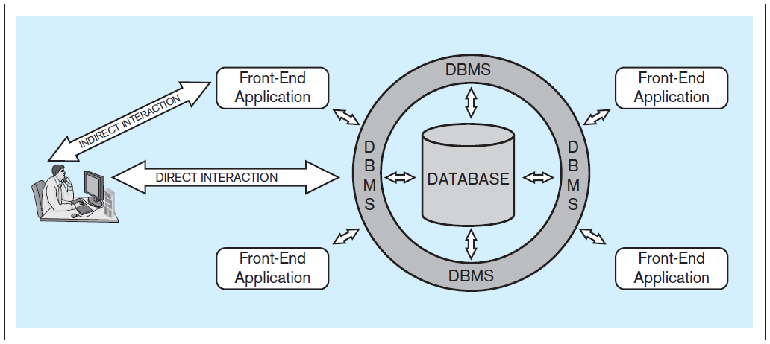
Database Application Architecture
A user can interact directly with a DBMS.
But more likely, the user interacts with a front-end application (such as a Python program) which in turn interacts directly with the DBMS.
Database Systems
by Jukić, Vrbsky, & Nestorov
Pearson 2014
ISBN 978-0-13-257567-6

Slide 27
Multiple Simultaneous Users
A DBMS can handle multiple simultaneous users and maintain data integrity.
The DBMS prevents users and their applications from stepping on each other and corrupting the data.
Database Systems
by Jukić, Vrbsky, & Nestorov
Pearson 2014
ISBN 978-0-13-257567-6

Slide 28
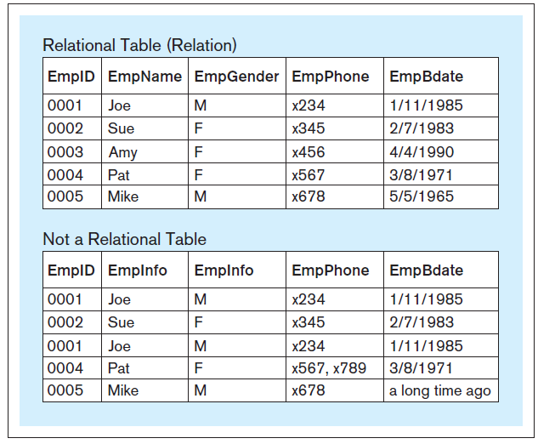
Table Structure in a Relational Database
Within a table of a relational database:
Each column must have a unique name.
All the values in each column must have the same datatype (e.g., all integers, all text, etc.)
Each row must be unique.
Within each row, each value in each column must be single-valued.
Row order and column order are irrelevant.
A table in a relational database
is also called a “relation”.
Why not?
Database Systems
by Jukić, Vrbsky, & Nestorov
Pearson 2014
ISBN 978-0-13-257567-6

Slide 29
Introduction to Database Queries
Introduction to Database Queries
web-based application:
https://www.apropos-logic.com/dbclass/
A website is created with HTML, CSS, PHP,
JavaScript, SQL, and AJAX programming
(but not Python).

Slide 30
Introduction to Database Queries
Introduction to Database Queries
web-based application:
https://www.apropos-logic.com/dbclass/
A website is created with HTML, CSS, PHP,
JavaScript, SQL, and AJAX programming
(but not Python).

Slide 31
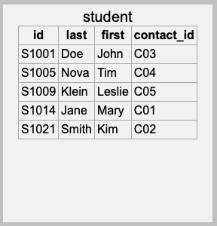
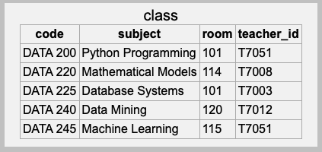
Primary Key
Each table must have a primary key.
A column or set of columns whose value uniquely identifies each row.
Primary key
Primary key
Intro 1

Slide 32
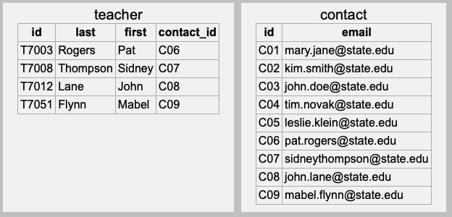
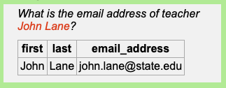
Foreign Keys
A table can have one or more columns of foreign keys that each refers to another table.
A foreign key value is equal to the primary key value of a row in the other table.
Intro 2
This is how the database
solves an address query!
Foreign key
Primary key

Slide 33
Break

Slide 34
Introduction to SQL
SQL (Structured Query Language) is the industry-standard language to program a relational database. It consists of:
Data Definition Language (DDL)
Create and modify the tables.
Data Manipulation Language (DML)
Insert, modify, delete, and retrieve data.
Data Control Language (DCL)
Facilitate data access control.
Transaction Control Language (TCL)
Manage database transactions.

Slide 35
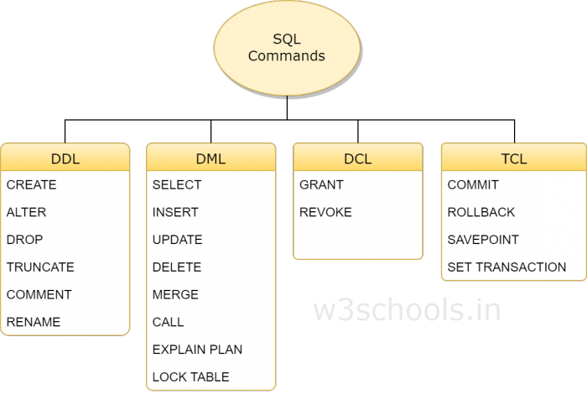
Introduction to SQL, cont’d
DDL: Data Definition Language
DML: Data Manipulation Language
DCL: Data Control Language
TCL: Transaction Control Language
We’ll start tonight with the SELECT command.
Then the INSERT, UPDATE, DELETE, CREATE, ALTER, and DROP commands.
Later, the GRANT, REVOKE, COMMIT, and ROLLBACK commands.
https://www.w3schools.in/mysql/ddl-dml-dcl/

Slide 36
SQL Syntax
SQL keywords are not case sensitive.
For clarity and consistency, we will use all caps for SQL keywords (such as SELECT).
Table and column names may be case sensitive.
It depends on your computer’s operating system.
The safest and most portable strategy is to use all lowercase for table and column names.

Slide 37
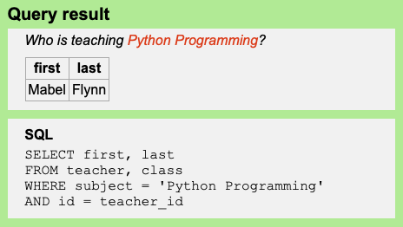
SQL Syntax, cont’d
An SQL statement can be written as one long line of text.
The first one or two words of a statement are the command keywords.
For legibility reasons, SQL statements are usually written as multiple lines of text.
Example:
Show SQL
In this SQL statement,
the command keyword
is SELECT. Other keywords
in the statement are FROM,
WHERE, and AND.

Slide 38
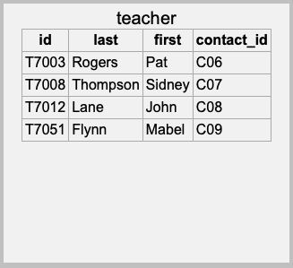
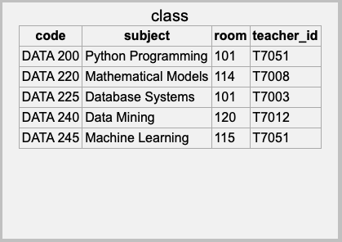
SQL Syntax, cont’d
The most commonly used command is SELECT to query a database in order to retrieve data that matches some criteria.
The matching criteria is not limited to the primary and foreign keys.
Which column values to return.
Which tables to search.
Selection criteria.

Slide 39
Table Join
To solve this query, we performed a join of two tables, teacher and class.
Which column values to return.
Which tables to search.
Selection criteria.

Slide 40
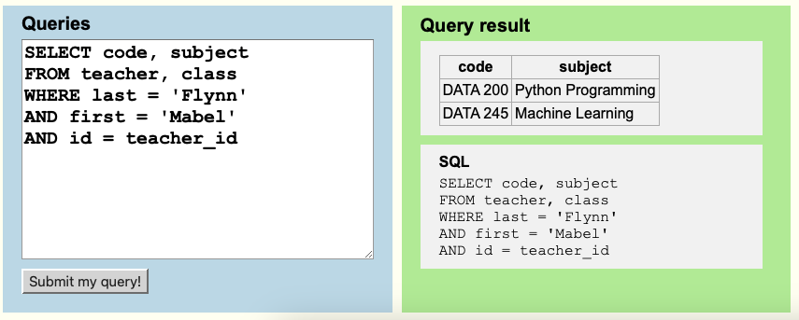
Write Your SQL Code
The Introduction to Database Queries web app allows you to type your own SQL code, execute it, and see what results you get.

Slide 41
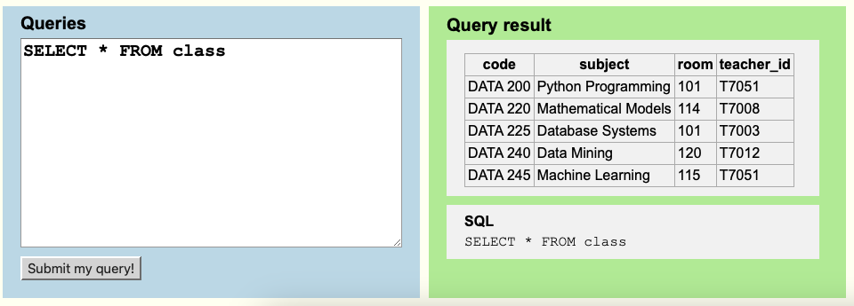
Display an Entire Table
All columns
Since there is no
selection criteria
(no WHERE clause),
all the rows are retrieved.

Slide 42
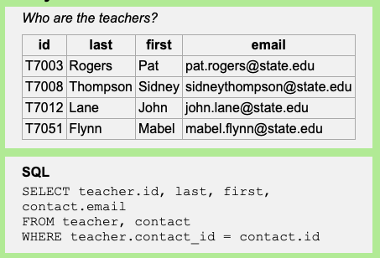
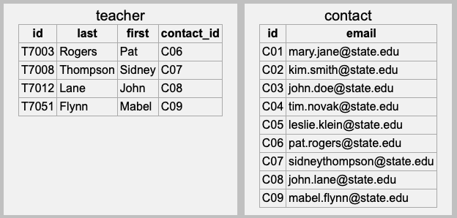
How a Query Works #1
Match each and every
teacher with an
email address.
We can always qualify a field name
with a table name even if it’s not
necessary. Doing so can make
things clearer:
teacher.contact_id
contact.id
Tables teacher and contact
each has a column named
id, so we must write
teacher.id to disambiguate.

Slide 43
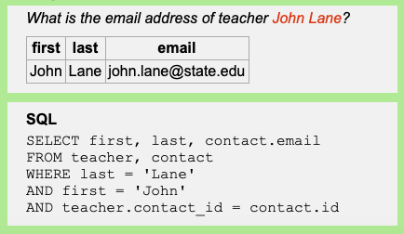
How a Query Works #2
Match a specific
teacher with an
email address.
Match the last and first names
to select the correct row in the
teacher table.
From the selected teacher row,
match teacher.contact_id
to contact.id.

Slide 44
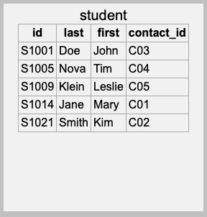
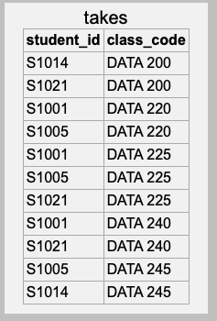
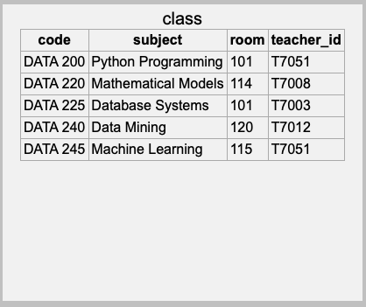
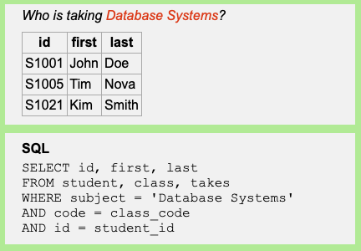
How a Query Works #3

Slide 45
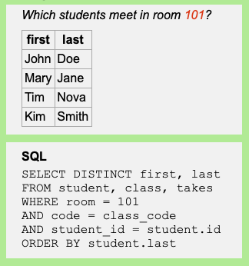
How a Query Works #4
Kim Smith will show up twice!
student.id S1021 matches
takes.student_id S1021 twice.
That’s why we use
SELECT DISTINCT.

Slide 46
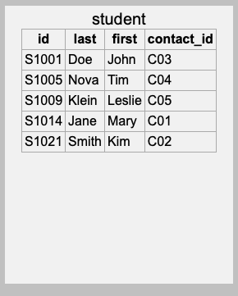
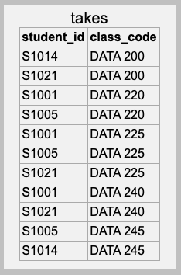

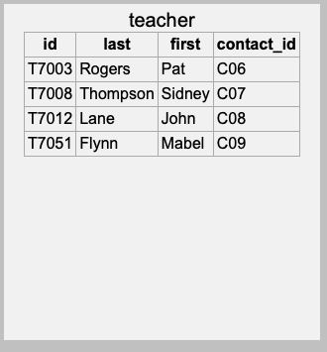
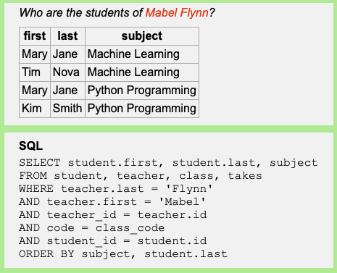
How a Query Works #5
Mary Jane matches twice!
Why don’t we need to use
SELECT DISTINCT this time?
ORDER BY subject, student.last
Sort the results first by subject,
then by the students’ last name.

Slide 47
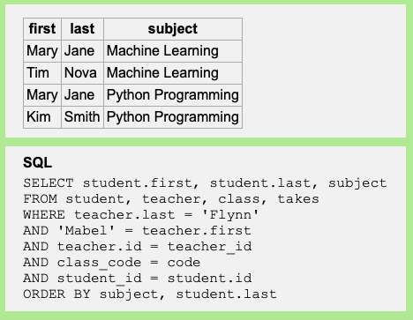
Order of Equality Comparisons
a = b is equivalent to b = a

Slide 48
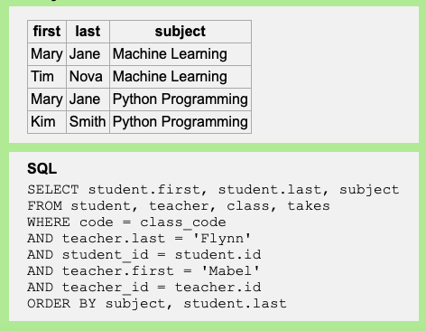
Order of WHERE Clauses
The order of WHERE clauses doesn’t matter.
The database server uses a query optimizer to determine the best execution path.

Slide 49
Assignment #1: Install Software
Do this assignment individually.
Due Monday, August 28 at 5:30 PM
Your platform can be Windows or macOS.
Install Python.
Install the MySQL DBMS.
The installation may include MySQL Workbench and the MySQL Connector/Python.
Use password seekrit for the root password
See “Software to Install”
in the syllabus for some
installation instructions.

Slide 50
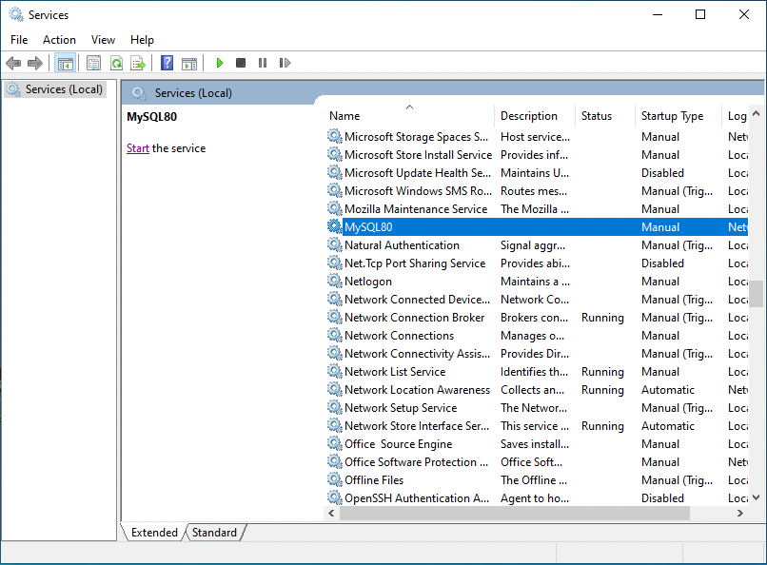
Assignment #1, cont’d
Start the MySQL DBMS on Windows.
In the bottom left of your screen, enter and run services.msc.
Find MySQL80 and start it.

Slide 51
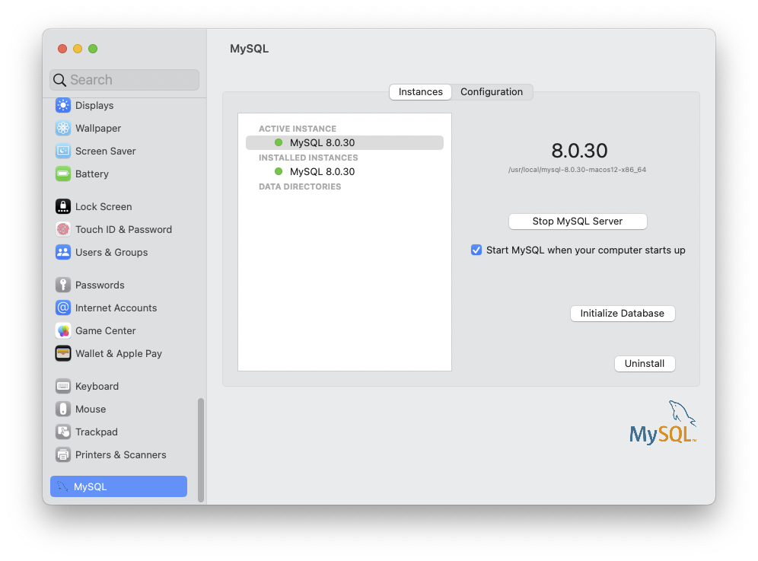
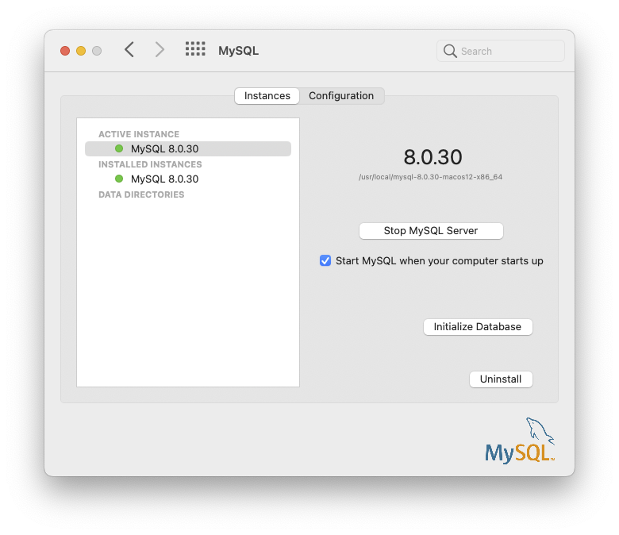
Assignment #1, cont’d
Start the MySQL DBMS on the Mac.
Open System Settings.
Open MySQL and start it.

Slide 52
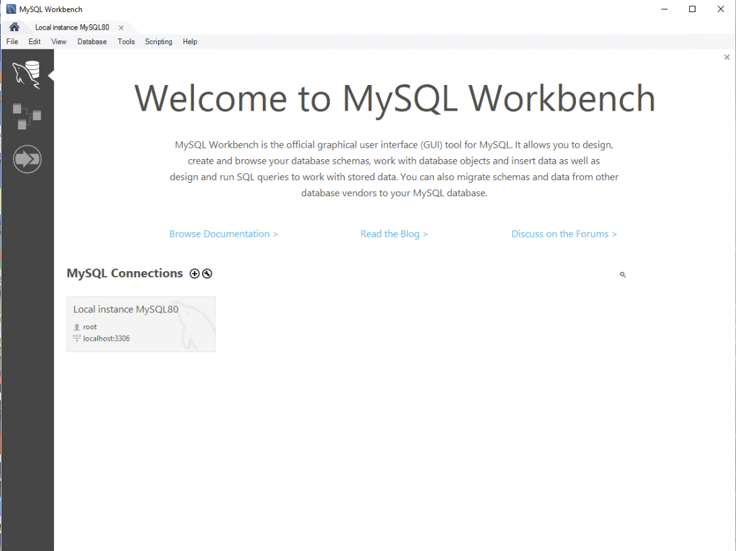
Assignment #1, cont’d
Install and start the MySQL Workbench tool.
Click on the Local instance tab.

Slide 53
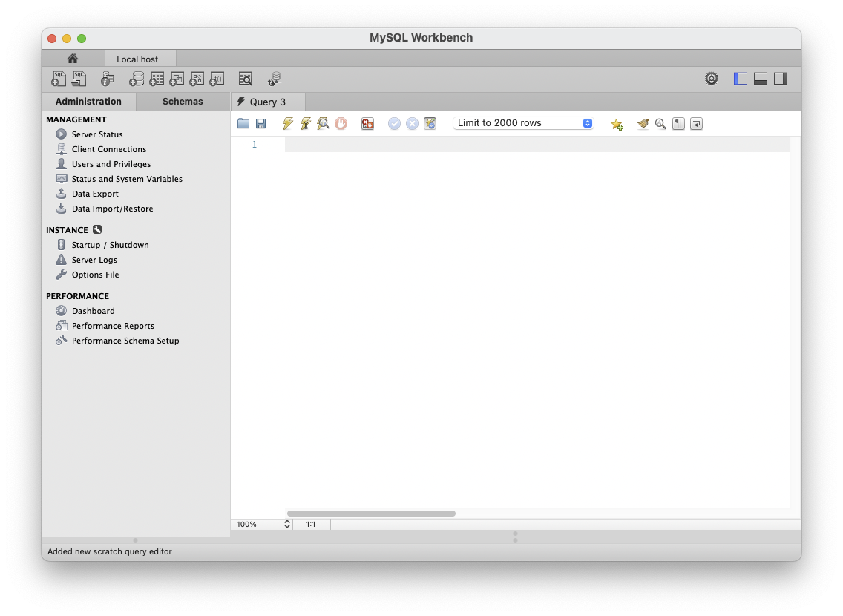
Assignment #1, cont’d
Click on Data Import/Restore

Slide 54
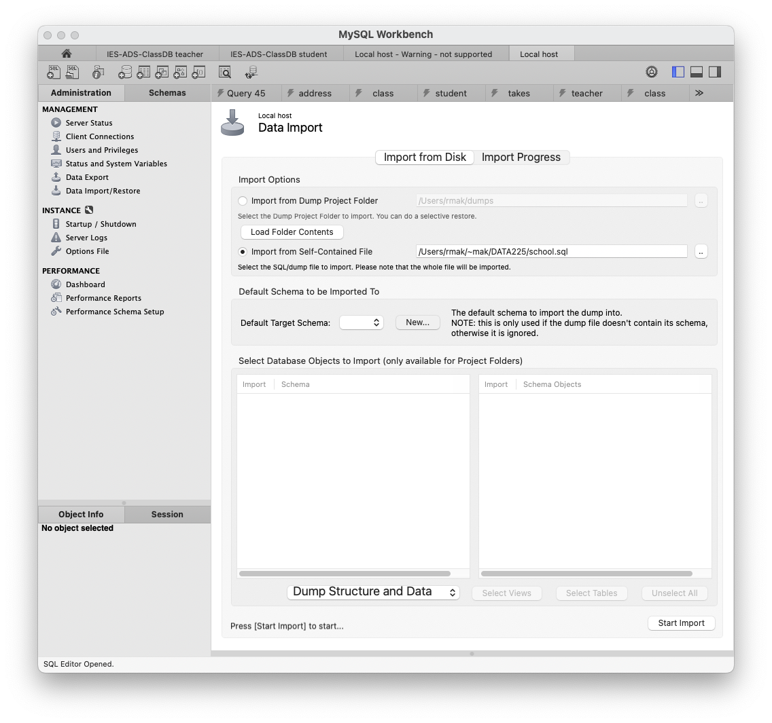
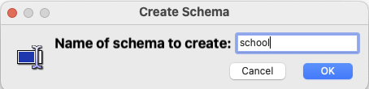
Assignment #1, cont’d
Load file school.sql into a new schema (database) named school.

Slide 55
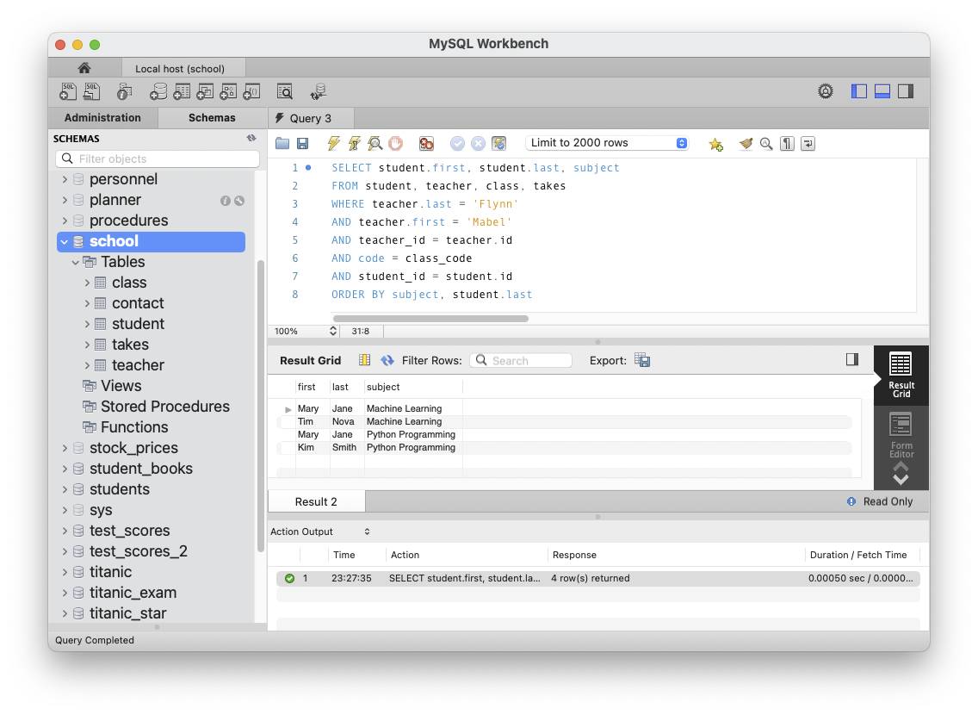
Assignment #1, cont’d
Go to the Schemas tab.
Click the refresh button.
Double-click on the school schema to select it, and then you type a query.
Click on the execute button.

Slide 56
Assignment #1, cont’d
Install the MySQL Connector/Python which enables a Python program to connect to a database and access its data.
You will be able to run a standalone Python program that connects to a database and queries its data.
You will also be able to run Python code in a notebook that connects to a database and queries its data.

Slide 57
Assignment #1, cont’d
What to submit for Assignment #1:
A screenshot of MySQL Workbench that shows
the school schema listed among the schemas
an SQL query (make up one or copy one from the “Introduction to SQL Queries” website)
the results of the query
A screenshot or text file of executing Assignment1.py of the standalone Connection program in a terminal.
A screenshot of the last three cells and their output from the notebook Assignment1.ipynb.

Slide 58
Form Teams!
Submit your team info into Canvas by Friday, August 25 by 11:59 PM
Only one member of the team needs to submit.
Name of the team
Name, student ID, and email address of each team member

